Slide 1
BCI wheelchair

Slide 2
0. S/W
Matlab (over ver. 2015 and under 2021b)
Instruments control toolbox
PTB-III (https://psychtoolbox.org/download.html)
Gstreamer (https://gstreamer.freedesktop.org/download/#windows)
OpenViBE (https://openvibe.inria.fr/downloads/)

Slide 3
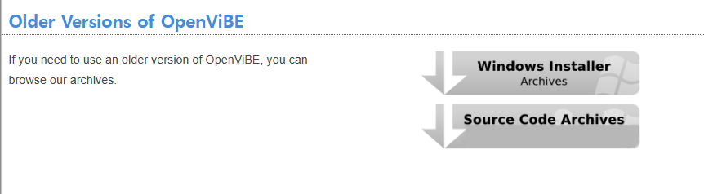
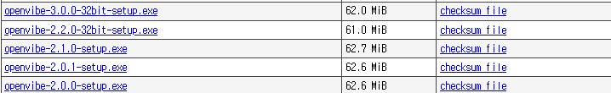
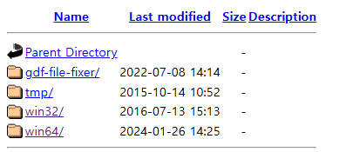
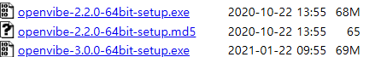
OpenViBE
https://openvibe.inria.fr/downloads/
Download ver. 2.2.0 (both 32 and 64bits)

Slide 4
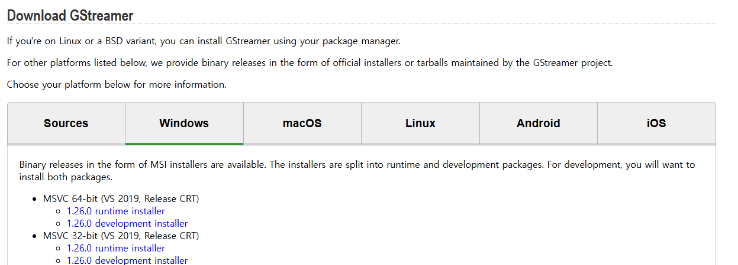
Gsteamer
https://gstreamer.freedesktop.org/download/#windows

Slide 5
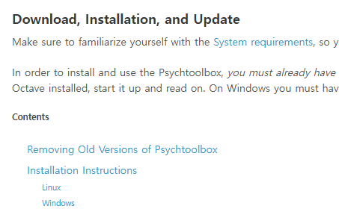
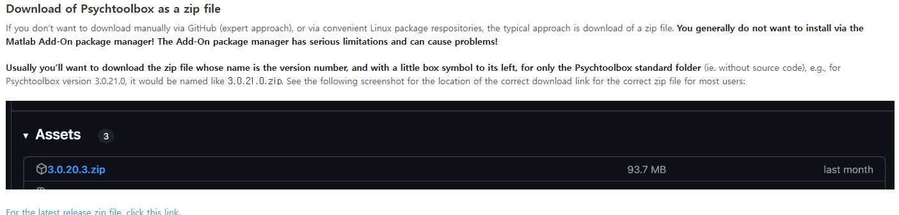
PTB-III
https://psychtoolbox.org/download.html
Required gsteamer
Download link

Slide 6
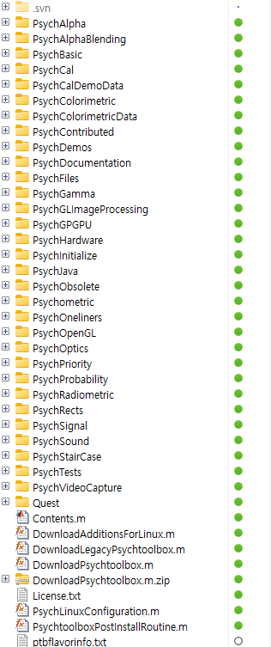
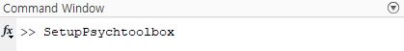
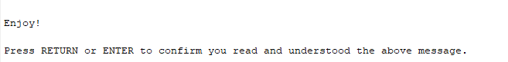
PTB-III
Path (in matlab)
In Matlab, Set path as: …/Psychtoolbox
Type the following in the Matlab command window
‘SetupPsychtoolbox.m’

Slide 7
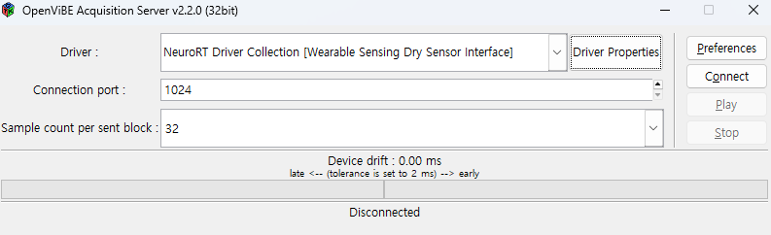
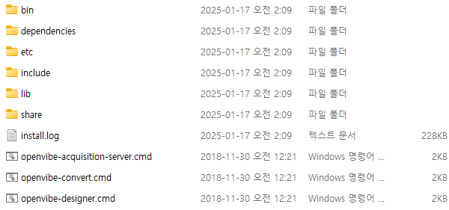
OpenViBE
Installed Path:
C:\Program Files (x86)\openvibe-2.2.0
C:\Program Files\openvibe-2.2.0-64bit
Please check!!
Acquisition server: 32-bits
Designer: 64-bits
Select Wearable sensing dry senser interface

Slide 8
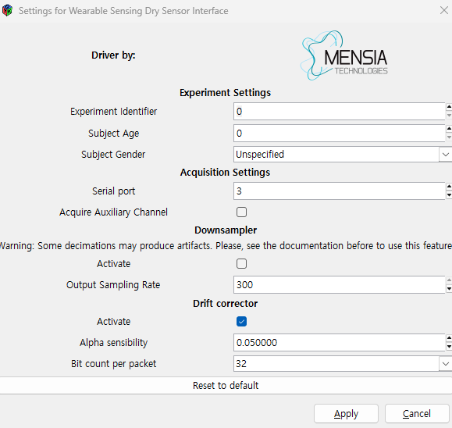
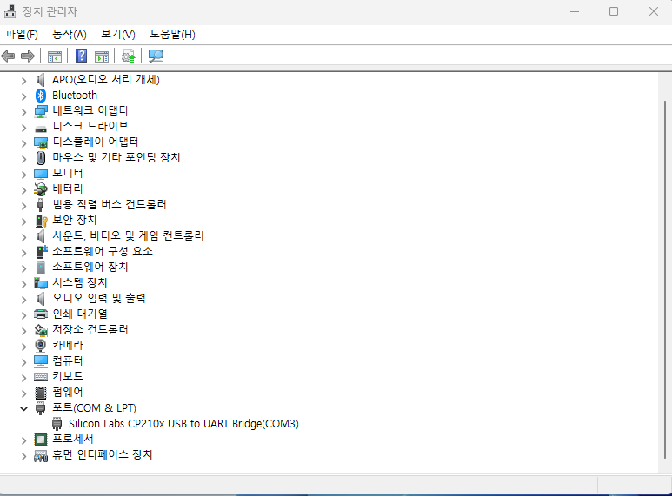
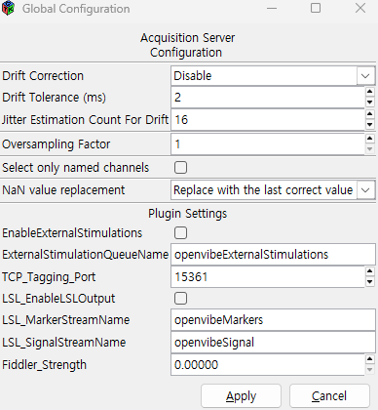
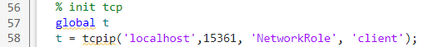
OpenViBE
Driver properties
Device Manager
Acquisition server (32 bits)
Preference
Port -> silicon labs cp210x usb to uart bridge(COM N)
In Matlab function
Matching

Slide 9
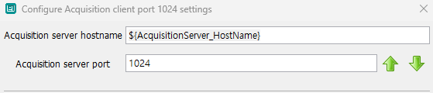
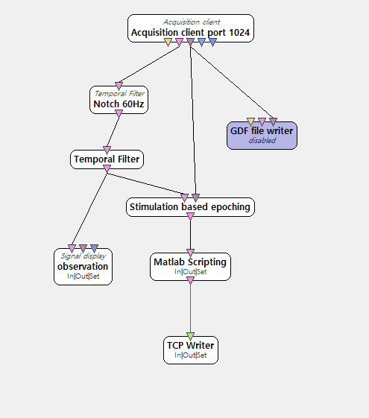
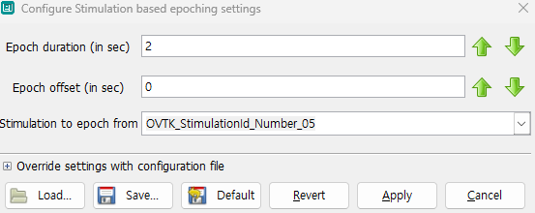
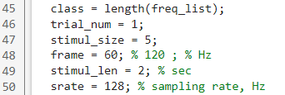
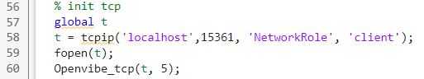
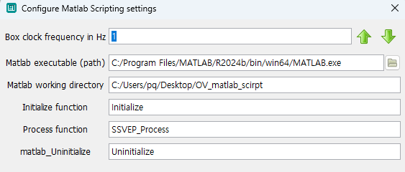
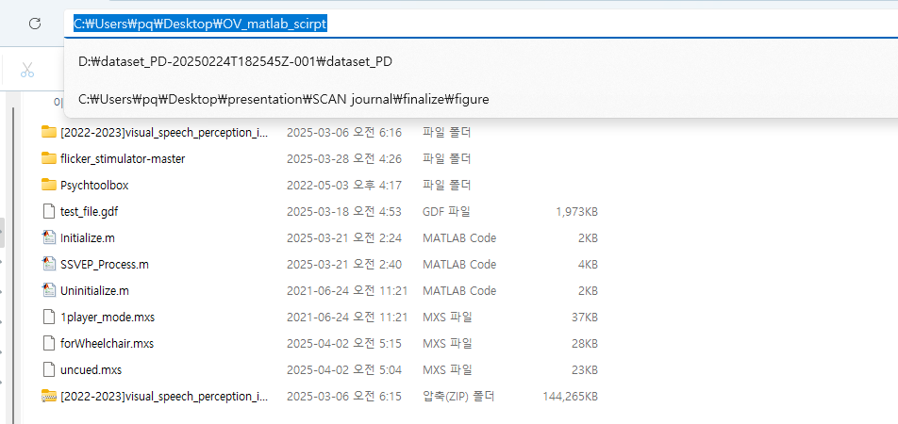
OpenViBE
Designer (64-bits)
Matching
Number_5
Matlab path
Project path

Slide 10
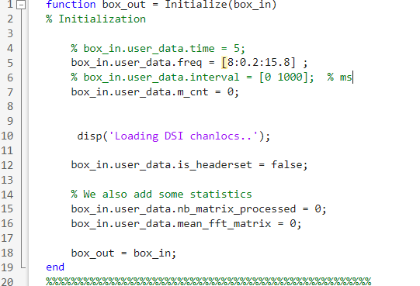
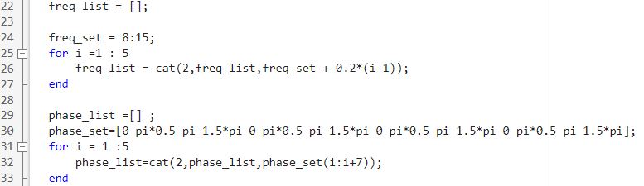
OpenViBE
OpenViBE project Initialize function
Custom BCI function
Designer (64-bits)
c

Slide 11
BCI function
Main function
square_flicker_4class_joint_phase_fixed_feedback.m
Util function
generate_freq.m
flickerTexture_all_class_circle.m
flickerTexture_all_class_fixed.m
Openvibe_tcp.m
shuffle_vec.m

Slide 12
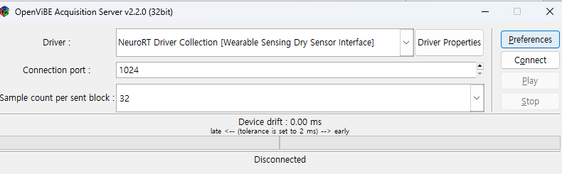
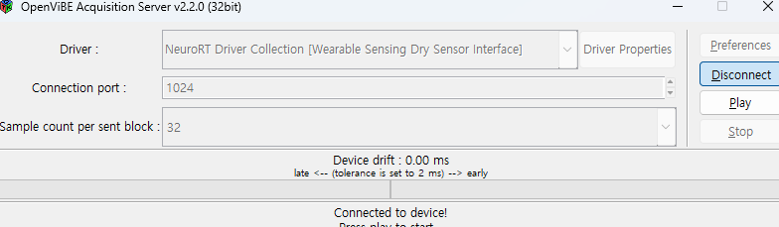
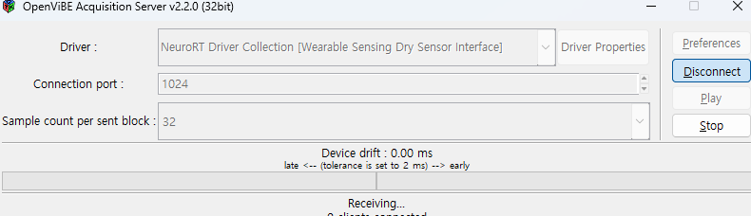
How to use
1. Acquisition Server
Click
Click

Slide 13
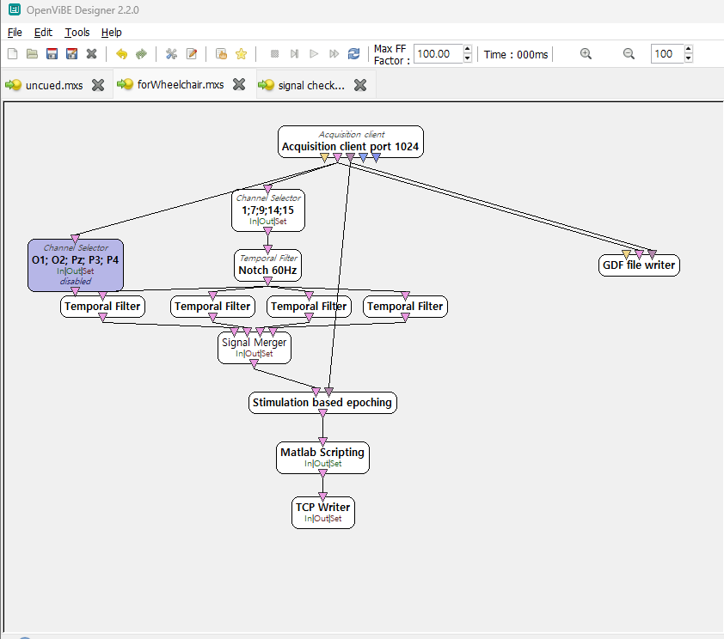
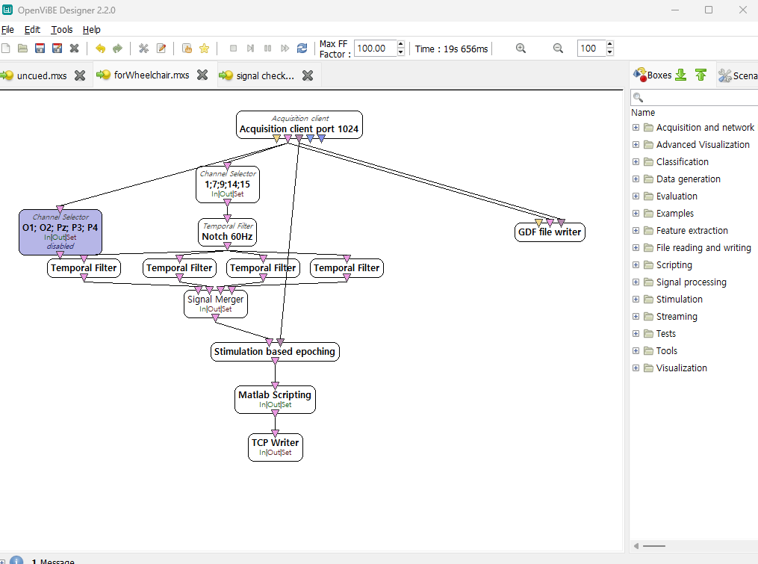
How to use
2. Degisner
Click
For wheelchair.mxs

Slide 14
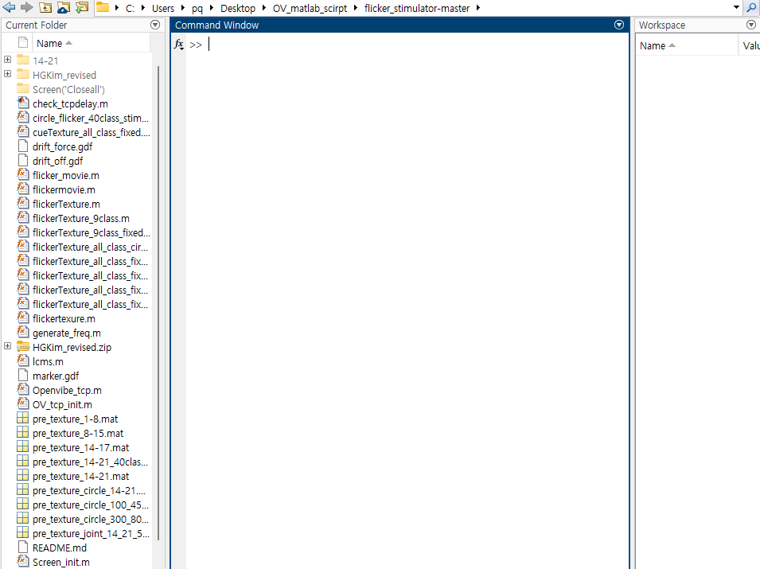
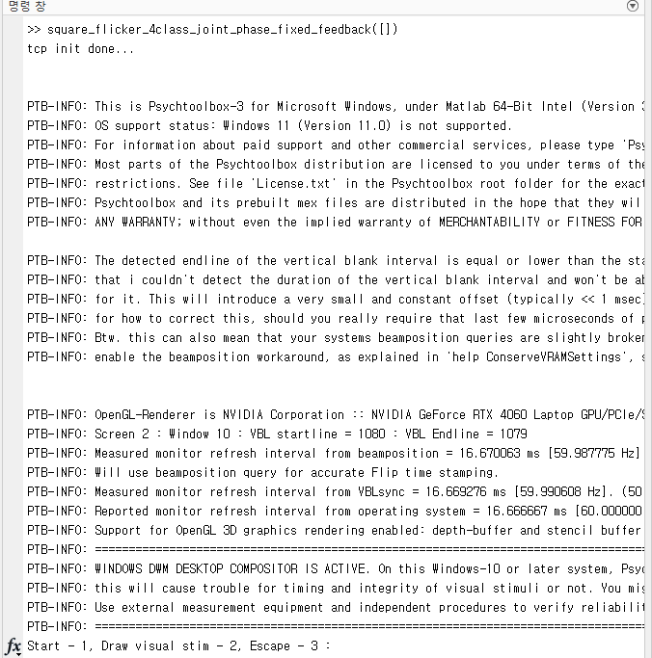
1. OpenViBE
3. Matlab
v
Enter the function as below
Enter number 1

Slide 15
Device components
Batteries * 2
Device
Micro USB(5 - pin)
for wired connection
Charger
Utility Tool
Wireless USB adapter
S/W

Slide 16
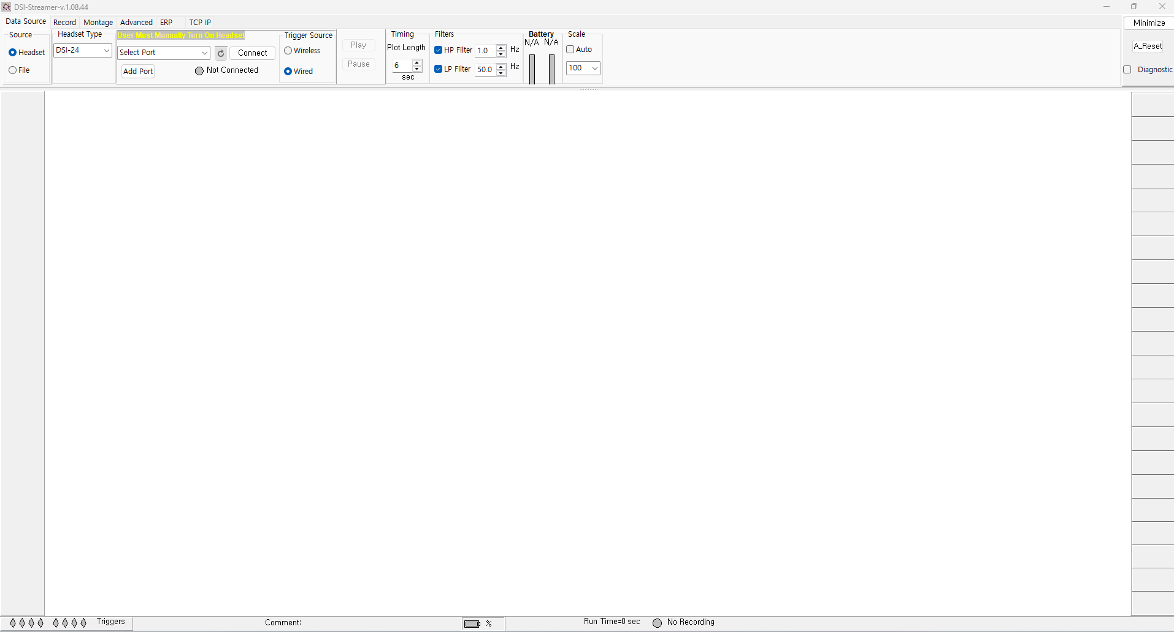
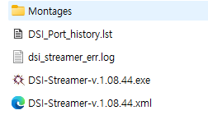
Setup
S/W
DSI-streamer (copy)
UART driver (install)
USB driver (install)

Slide 17
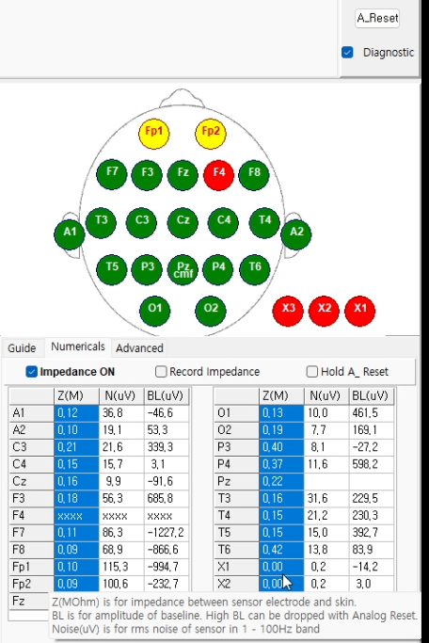
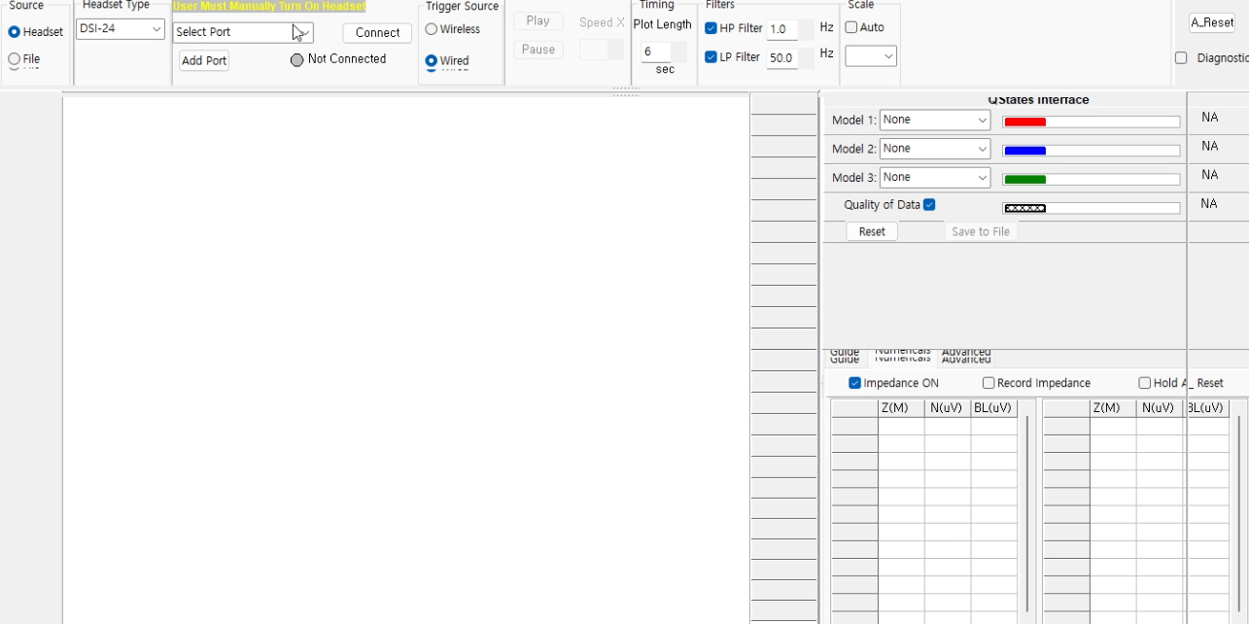
Streamer
Device Manager → UART USB port # (ex; COM 3)
Check Diagnostic
Wired or wireless → connect
Check
Imp. on
Recommend:
Z < 0.5

Slide 18
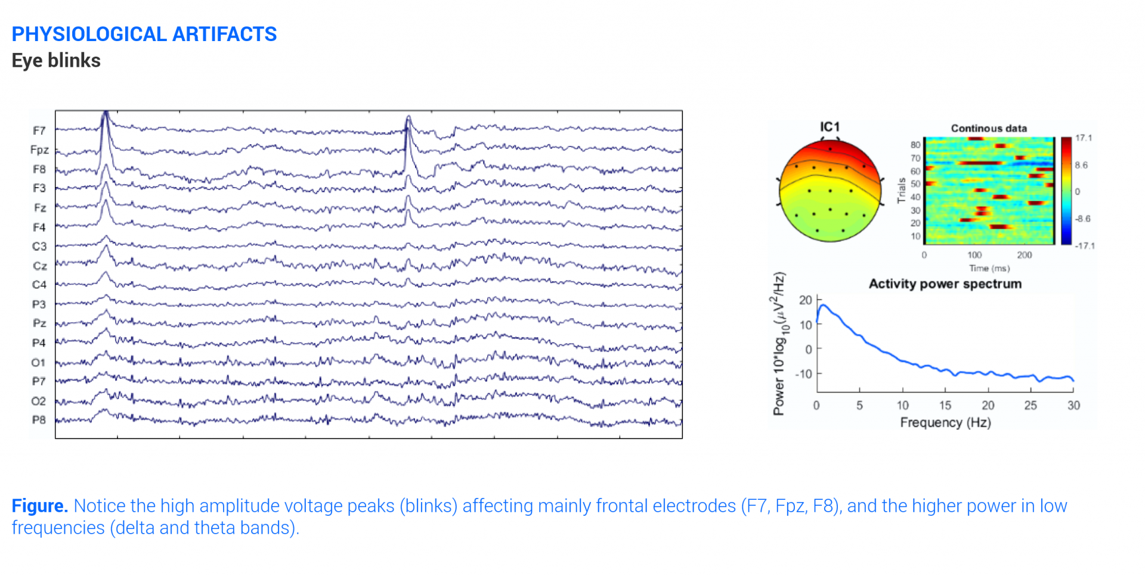
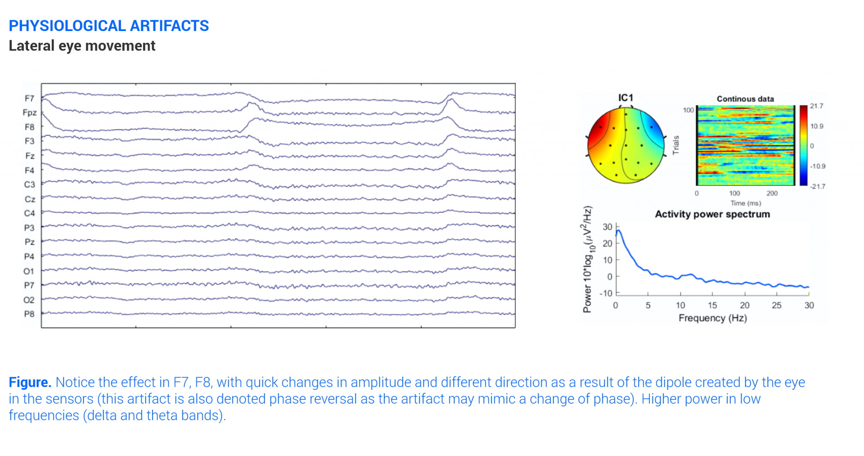
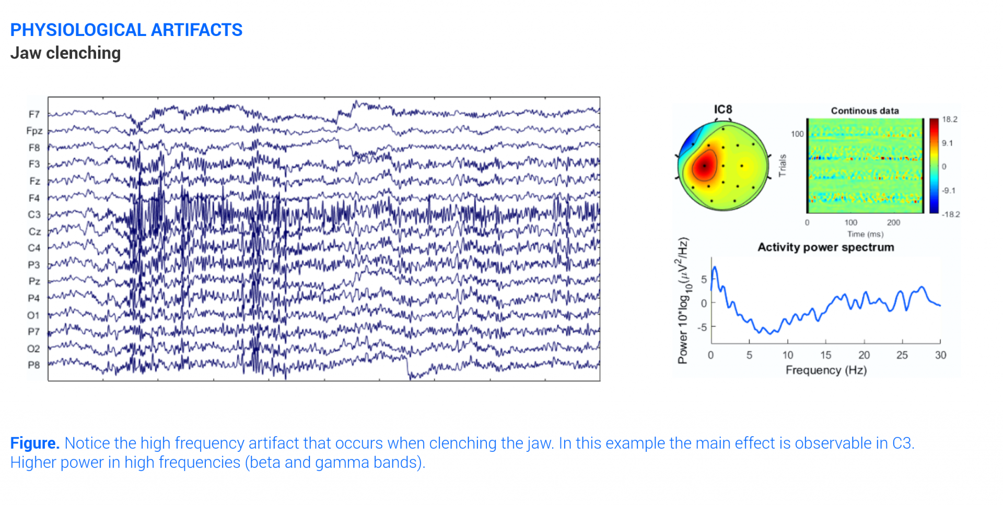
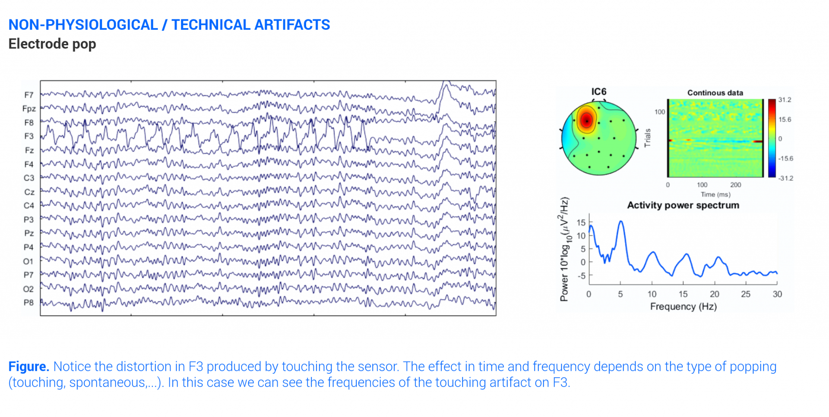
Signal check – remarkable artifacts

Slide 19
Device position
Parallel
Eyebrows

Slide 20
Device
1. Position headset
2. Rotate knob clockwise to tighten headset
3. Hold the top board
4. Attach earlobes
5. Use utility tool to work sensor
*. Wired connector

Slide 21
Status check
Turn on: press On/Off button twice
Turn off: press and hold On/Off → Rapid flashing of the Status LED
Status check
Turn on & not connected: slowly flickering of Status LED
Turn on & connected: turn off all LED, and press status button → 2 times flashing of Status LED

